Slide 1


Jennifer Schaus & Associates
GOV CON WEBINAR SERIES - 2017

Slide 2
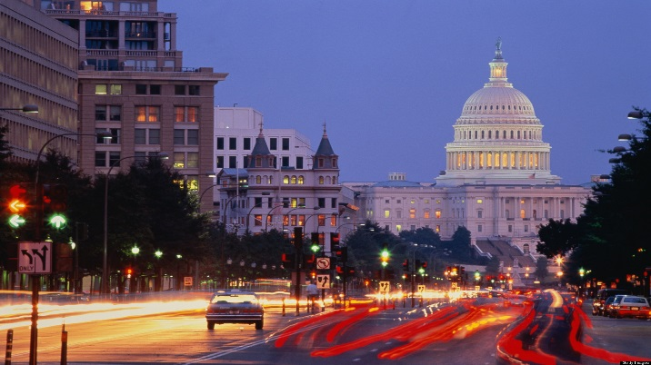
Jennifer Schaus & Associates – GOV CON WEBINAR SERIES - 2017 - WASHINGTON DC www.JenniferSchaus.com
Join Us for A Series of Complimentary Webinars
on various US Federal Government Contracting Topics.
Presenters are industry experts
sharing knowledge
about the competitive government contracting sector.
Find all of our Govt Contracting webinars (free download) at www.JenniferSchaus.com
Contact Us @ 2 0 2 – 3 6 5 – 0 5 9 8

Slide 3

Jennifer Schaus & Associates – GOV CON WEBINAR SERIES - 2017 - WASHINGTON DC www.JenniferSchaus.com
ABOUT JENNIFER SCHAUS & ASSOCIATES:
Based in downtown Washington, DC;
A la carte services for Federal Contractors;
Proposal Writing to GSA Schedules and Contract Administration, etc.;
Deep bench of industry experts;
Educational webinars;
Networking events and seminars;
WEBSITE: http://www.JenniferSchaus.com

Slide 4


Jennifer Schaus & Associates – GOV CON WEBINAR SERIES - 2017 - WASHINGTON DC www.JenniferSchaus.com
ABOUT JENNIFER SCHAUS:
Began career with D&B;
Over 20 years in federal contracting;
Industry speaker and author;
Board Member: GovLish; NCMA; and NMIA.
Volunteer Mentor &/or Instructor: VA PTAP; CBP / VBOC; Capitol Post; 1776; Eastern Foundry, WIT; WDCEP and the Towson University Incubator.

Slide 5

Jennifer Schaus & Associates – GOV CON WEBINAR SERIES - 2017 - WASHINGTON DC www.JenniferSchaus.com
ABOUT OUR SPEAKER
MARK A. AMADEO, ESQ.

Slide 6
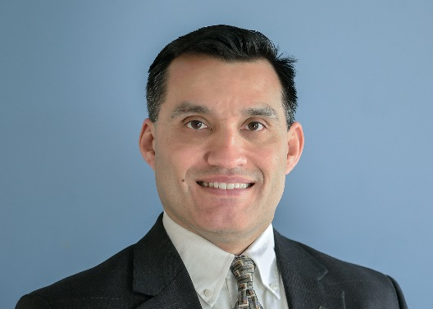
Jennifer Schaus & Associates – GOV CON WEBINAR SERIES - 2017 - WASHINGTON DC www.JenniferSchaus.com
ABOUT MARK A. AMADEO
Founder & Managing Partner of Amadeo Law Firm, PLLC
Over 20 years of experience as government counsel & law firm counsel
Before starting boutique law firm, was a partner at DC law firm
Litigation background in complex cases helps avoid pitfalls
LL.M. Georgetown University Law Center; J.D. University of Wisconsin Law School; B.A. Boston College
Member of several business, government contracting & technology groups in DC, Maryland & Virginia
Phone: (202) 640-2090 Email: mamadeo@amadeolaw.com

Slide 7
Jennifer Schaus & Associates – GOV CON WEBINAR SERIES - 2017 - WASHINGTON DC www.JenniferSchaus.com
ABOUT AMADEO LAW FIRM, PLLC
Boutique With Offices in DC, Bethesda & Frederick
Focus on Government Contracting & Technology
Review/negotiation: FAR/DFARS complianc
Pre & Post Award Teaming: JV’s & Subcontracts
Technology: IP preservation & commercialization
WEBSITE: http://www.amadeolaw.com

Slide 8
Jennifer Schaus & Associates – GOV CON WEBINAR SERIES - 2017 - WASHINGTON DC www.JenniferSchaus.com
BEST PRACTICES IN CONTRACT CLOSEOUTS
Wednesday, September 27, 2017

Slide 9
Jennifer Schaus & Associates – GOV CON WEBINAR SERIES - 2017 - WASHINGTON DC www.JenniferSchaus.com
WHICH FILES?
Agency Files
History of Transaction
Background
Support Actions Taken
Reviews & Investigations
Essential Facts – Litigation & Congressional Inquiry
Three Categories
Cancelled Solicitation
Contract
Contractor

Slide 10
Jennifer Schaus & Associates – GOV CON WEBINAR SERIES - 2017 - WASHINGTON DC www.JenniferSchaus.com
WHICH FILES?
Contract Files
Contracting Office Contract File
42 Examples – Pre-solicitation, Solicitation, Award & Post-Award
Contract Administration Office File
20 Examples – Contract & Modifications, Subcontract Consents, Property Administration Records
Paying Office Contract File
Prerequisites & Contract Payments

Slide 11
Jennifer Schaus & Associates – GOV CON WEBINAR SERIES - 2017 - WASHINGTON DC www.JenniferSchaus.com
CLOSEOUT
Timing
Closeout Contract Administration Office File
Simplified Acquisition – receipt of property & final payment
FFP – w/in 6 months of evidence of physical completion
Indirect Costs – within 36 months of evidence of physical completion
All Others – within 20 months of evidence of physical completion
Closeout Contract Office File
Simplified Acquisition – receipt of property & final payment
Others - Receives Contract Completion Statement
Closeout Paying Office Contract File
Upon Final Payment Voucher

Slide 12
Jennifer Schaus & Associates – GOV CON WEBINAR SERIES - 2017 - WASHINGTON DC www.JenniferSchaus.com
Contract File Must Be Physically Completed
Supplies & Services
Actually Completed
Deliveries Completed, Inspected & Accepted
Services Performed & Accepted
Options Expired
OR
Complete Contract Termination

Slide 13
Jennifer Schaus & Associates – GOV CON WEBINAR SERIES - 2017 - WASHINGTON DC www.JenniferSchaus.com
Contract File Must Be Physically Completed
Rental, Use or Storage
Contract Period Expires
OR
Complete Contract Termination

Slide 14
Jennifer Schaus & Associates – GOV CON WEBINAR SERIES - 2017 - WASHINGTON DC www.JenniferSchaus.com
Procedures
Contract Administration Office
Disposition of Classified Materials Completed
Final Patent Report Cleared
Final Royalty Report Cleared
No Outstanding Value Engineering Change Proposal
Plant Clearance Report Received
Property Clearance Report Received
Interim Or disallowed Costs Settled
Price Revisions Completed
Subcontracts Settled
Prior Year Indirect Costs Settled
Termination Docket Completed
Contract Audit Completed
Contractor’s Closing Statement Completed
Contractor’s Final Invoice Submitted
Contract Funds Review Completed, Excess Funds Deobligated

Slide 15
Jennifer Schaus & Associates – GOV CON WEBINAR SERIES - 2017 - WASHINGTON DC www.JenniferSchaus.com
Procedures
Contract Completion Statement
Contract administration office name & address
Contract Number
Last Modification Number
Last Call or Order Number
Contractor Name & Address
Price Revisions Completed
Dollar Amount of Any Excess Funds
Voucher Number & Date, If Final Payment Made
Invoice Number & Date If Final Payment Approved
Statement That All Required Contract Administration Actions Accomplished
Name & Signature of Contracting Officer
Date

Slide 16
Jennifer Schaus & Associates – GOV CON WEBINAR SERIES - 2017 - WASHINGTON DC www.JenniferSchaus.com
Quick Closeout Procedure
Direct & Indirect Costs Negotiated In Advance
If unsettled direct costs & indirect costs are relatively insignificant – do not exceed the lesser of
$1,000,000
10% of the total contract value
Contracting Officer Performs Risk Assessment - including
Contractor’s accounting, estimating, purchasing systems
History of approved indirect cost rate agreements
Quick Close Out Determinations Are Final
Cannot Be Used For Other Contracts

Slide 17
Jennifer Schaus & Associates – GOV CON WEBINAR SERIES - 2017 - WASHINGTON DC www.JenniferSchaus.com
BEST PRACTICES
General
Anticipate Close Out At Very Beginning
Use A Detailed Checklist
Have Forms Ready
Use Quick Close Out When Possible
Keep A Team On The Project
Close Out Meeting

Slide 18
Jennifer Schaus & Associates – GOV CON WEBINAR SERIES - 2017 - WASHINGTON DC www.JenniferSchaus.com
BEST PRACTICES
Specific
Subcontracts
Close Out Early
Favor Ones That Don’t Require Formal Close Out
Payments & Costs
Maintain accurate information
Reconcile vouchers ASAP
Property
Inventory
Walk Through

Slide 19
Jennifer Schaus & Associates – GOV CON WEBINAR SERIES - 2017 - WASHINGTON DC www.JenniferSchaus.com
Why Does It Matter?
Reputation
Collect Money Owed
Efficient Use of Resources
Reduce Cost

Slide 20
Jennifer Schaus & Associates
GOV CON WEBINAR SERIES - 2017
QUESTIONS?
CONTACT OUR SPEAKER (MARK A. AMADEO) AT (202-640-2090) AND AT (mamadeo@amadeolaw.com)
THANK YOU FOR ATTENDING!! WWW.JENNIFERSCHAUS.COM

